Slide 1
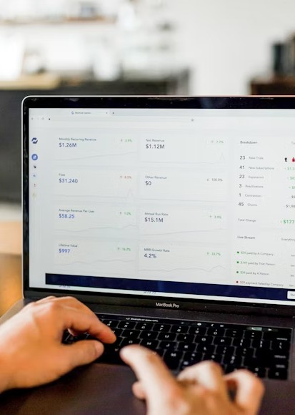
Telecom User Sentiment Analysis
A Comparative Dataset of Positive and Negative Feedback
Prepared by JCDS2602 - Group 5:
Clarinda Puspitajati,
Hans Darmawan, and
Ridha Hayat
April 8th, 2025

Slide 2
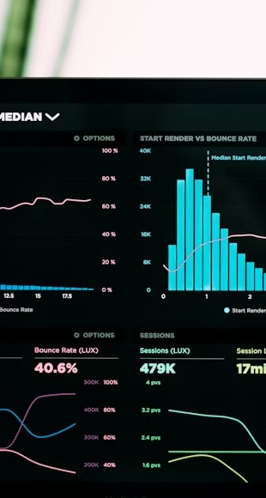
Presentation Overview
What We'll Cover:
Industry context and challenges
Data collection and preparation
Text analysis methodology
Key findings from sentiment analysis
Actionable recommendations

Slide 3

Industry Context
Key Points:
Telecom market faces intense competition
Customer loyalty directly impacts revenue
Social media offers real-time feedback
Data-driven decisions improve service quality

Slide 4
Current Challenges
Main Issues:
Network reliability concerns Price-value perception gaps
Business Impact:
Customer churn affects long-term growth

Slide 5
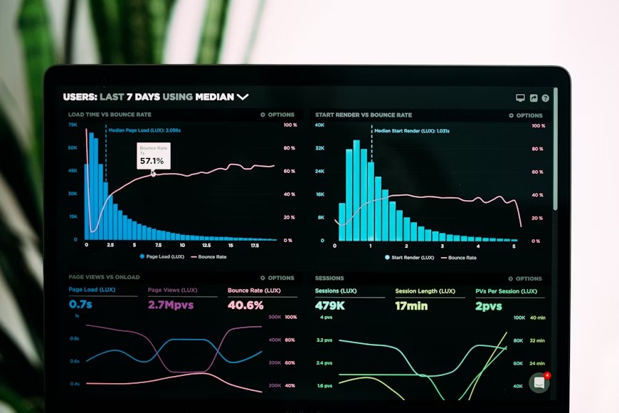
Service Gaps
Key Gaps:
Performance Gap: Actual vs. promised service
Value Gap: Price perception vs. benefits

Slide 6

Research Questions
Our Analysis Focuses On:
How do users feel about network quality?
Which factors drive satisfaction or frustration?

Slide 7
Data Collection
Our Approach:
Gathered 300 Twitter Tweets
Used standard data analysis tools
Verified data quality and completeness
Organized for efficient processing

Slide 8
Text Preparation
Cleaning Process:
Standardized text to lowercase
Removed irrelevant elements
Filtered common words
Example:
Before: "@TelcoProvider your network is DOWN AGAIN! #frustrated #badservice This is the 3rd time this week!!!"
After: "telcoprovider network down 3rd time week"

Slide 9

Text Normalization
Word Processing:
Root Form Extraction: Converting variations to base words
Context-Aware Processing: Maintaining proper meaning

Slide 10
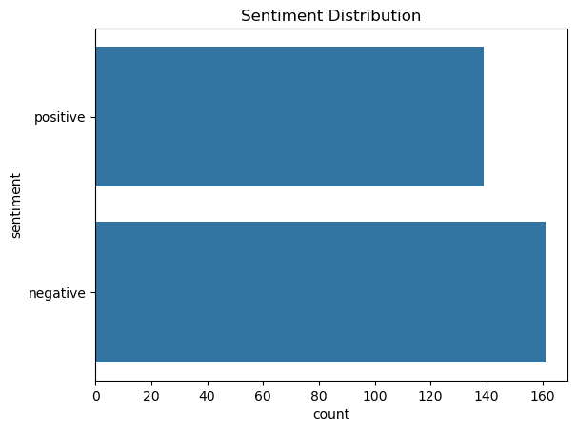
Data Overview
Sentiment Breakdown:
Nearly balanced dataset
140 positive comments
160 negative comments

Slide 11
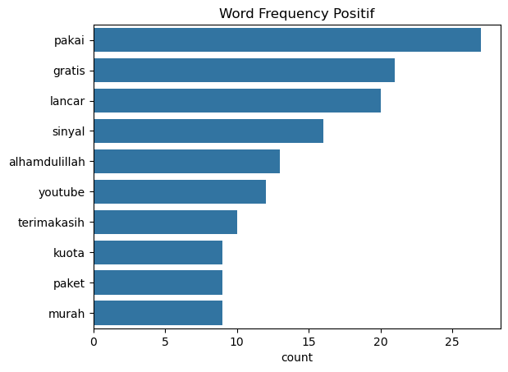
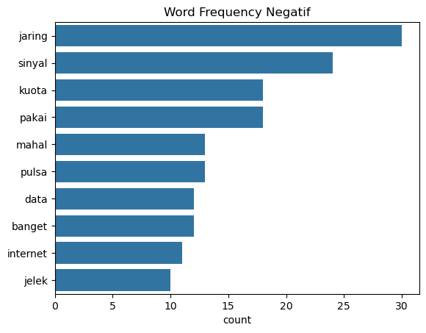
Key Terms Analysis

Slide 12
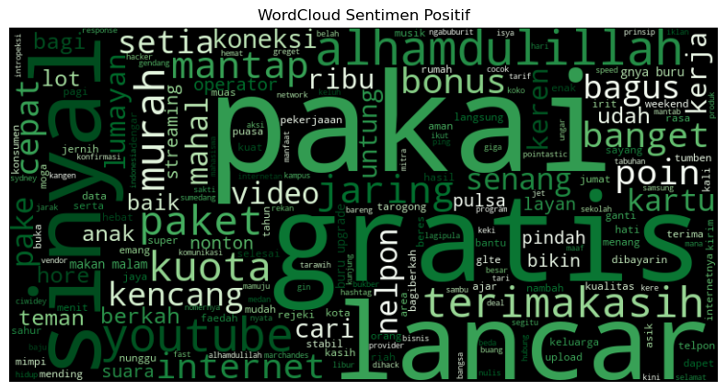
Key Terms Analysis

Slide 13
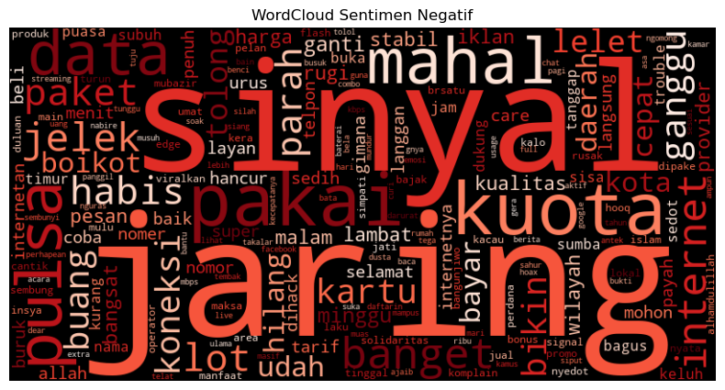
Key Terms Analysis

Slide 14
Main Findings
Positive Feedback Negative Feedback
Free services
Smooth connections
Network issues
High costs

Slide 15

Recommendations
Network Enhancement
Target improvement in high-traffic areas Increase bandwidth during peak hours
Value-Based Pricing
Create transparent pricing tiers
Develop loyalty rewards program

Slide 16

Summary
Key Takeaways:
Addressing core issues will boost satisfaction
Data-driven approach enables targeted solutions

Slide 17
_{Thank You!}Questions Welcome

